Slide 1
VPEX Solutions
By unrated

Slide 2









Problemsetters
Testers
Other
Do the problems bobliu

Slide 3
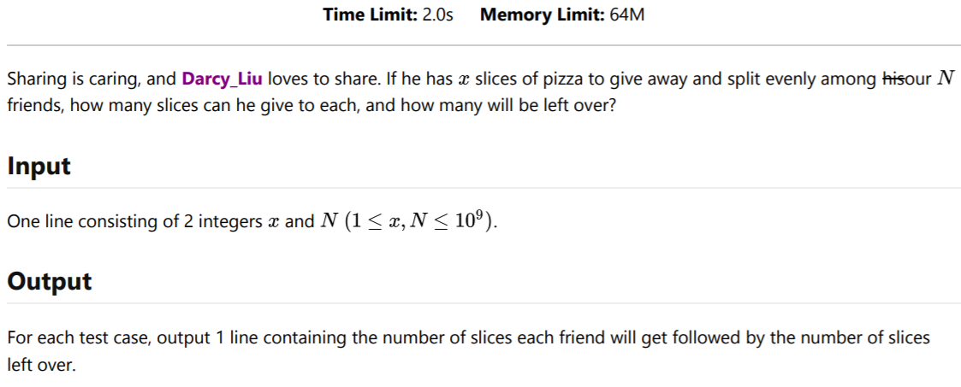
Problem 0 - Pizza

Slide 4
Solution
We are dividing x slices among N friends. Each friend gets x/N slices, rounded down. There are x mod N slices left over.
Time complexity: O(1)
Key concepts: simple math

Slide 5
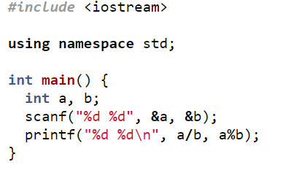
Code (c++)

Slide 6
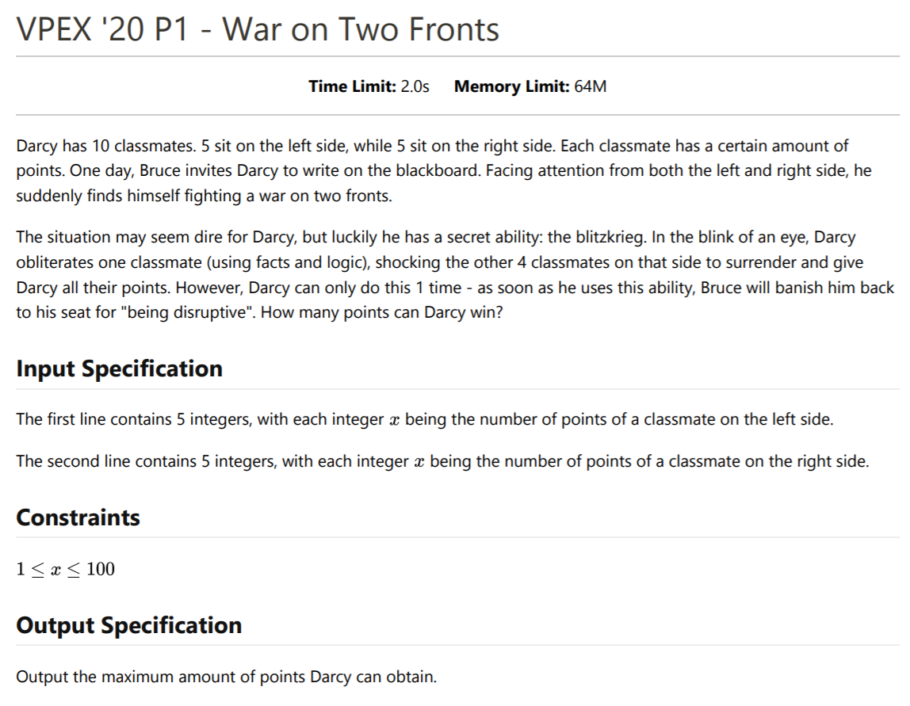

Slide 7
Solution
The person Darcy attacks does not give any points, so Darcy should attack the person with the least points.
For each side, simply add up the points of every person and subtract the minimum. Then find the maximum of these 2 results.
Time complexity: O(1), as there are only 10 people in total
Key concepts: none Key concepts: 20th century war strategy

Slide 8
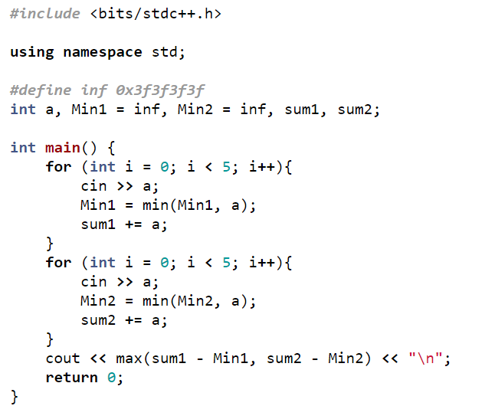
Code (c++)

Slide 9
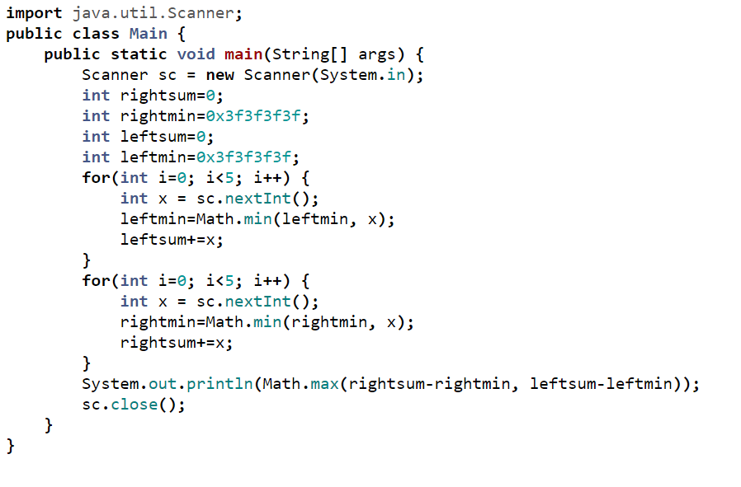
Code (Java)

Slide 10
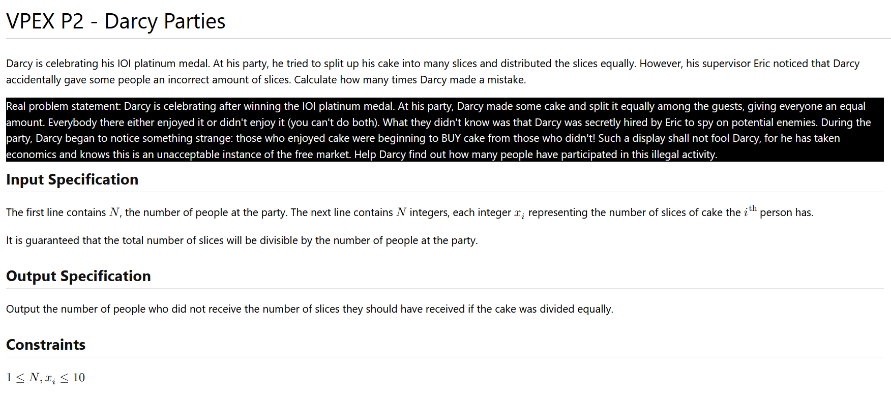
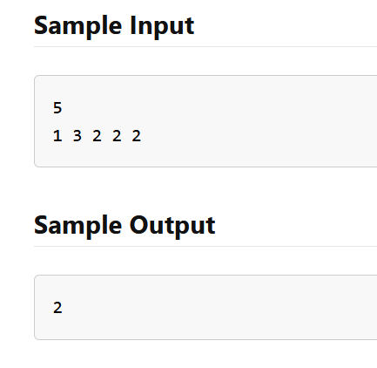

Slide 11
Solution
Whenever a person sells cake to another person, the total amount of cake does not change. So you can find the amount of cake everyone starts off with by dividing the total amount by the number of people.
If someone sells cake, they will have less than they started with. If someone buys cake, they will have more. No one will buy and then sell because you can’t like and dislike cake at the same time. Count the number of people who do not have the amount they started off with to get your answer.
Time complexity: O(N)
Key concepts: simple math

Slide 12
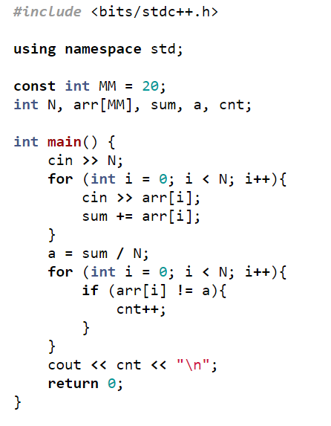
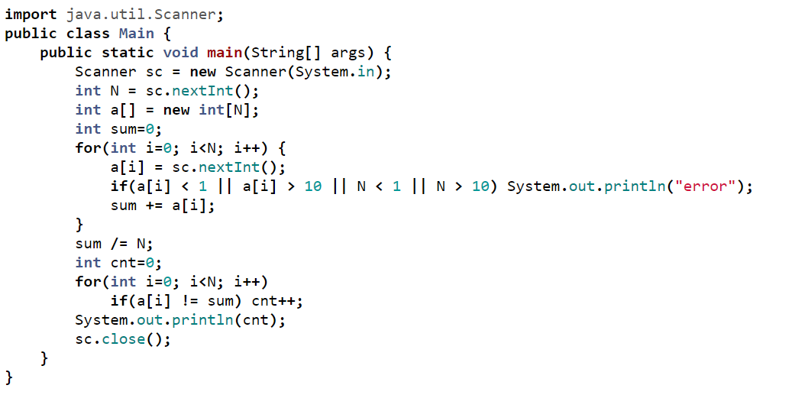
Code (Java)
C++

Slide 13
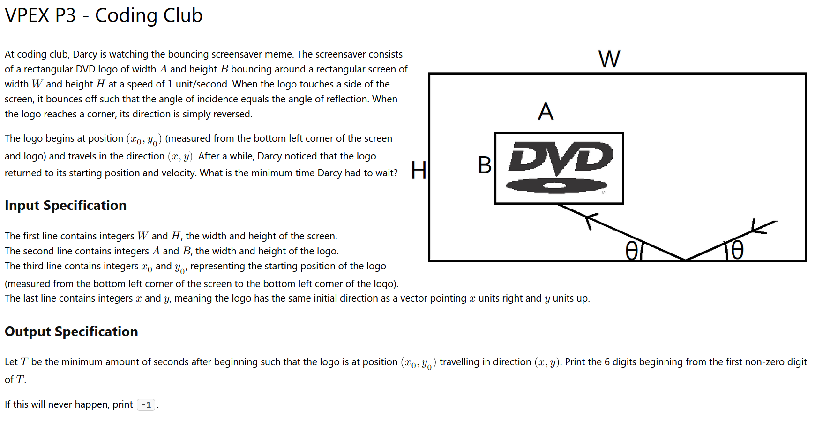

Slide 14
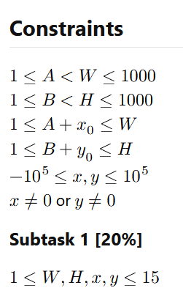
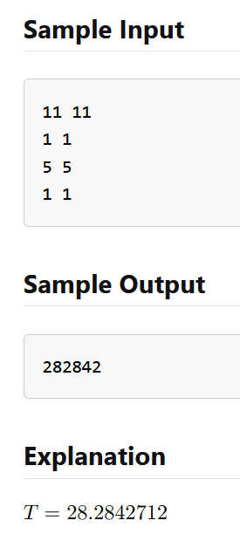

Slide 15
Subtask 1 Solution
The values are so small, it is enough to simply simulate the rectangle, changing its direction every time it bounces off a wall.
When the box has the same position and is travelling in the same direction as it started in, the animation will begin to loop.
Time complexity: about O(AB), depending on how you implement
Key concepts: implementation

Slide 16
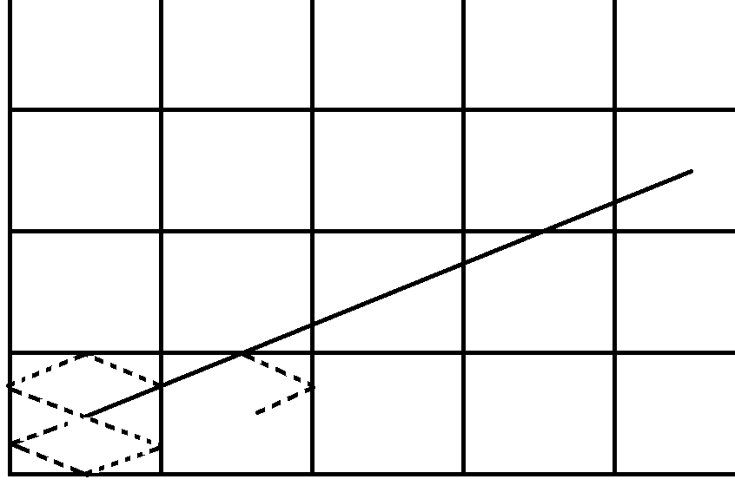
Full Solution
Instead of a AxB logo bouncing around a WxH screen, you can focus on the bottom left point bouncing around a (W-A)x(H-B) box. This can then be imagined as a point travelling in a line through an infinite grid of (W-A)x(H-B) cells.
When then point travels through an even number of cells vertically, it will have bounced an even number of times vertically. Same thing for the horizontal direction. When this has happened, the box will be travelling in its starting direction.
The box also needs to have travelled to its original position, so the vertical and horizontal displacement must be divisible by the cell height and width.

Slide 17
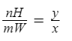
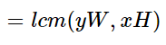
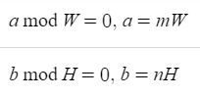
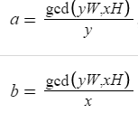
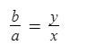
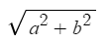
Full solution
Then
because it’s the first time this happens
So
The distance is
And travelling at one unit/second, it’s also the time taken.
You can also see that the output will never be -1.
Remember the special cases where x=0 or y=0, where the point only travels in one direction.
Also remember to store your output as a double to avoid integer overflow.
Time complexity: O(log(max(x,y,W,H)))
Key concepts needed: Simple math
If a is the horizontal displacement, and b is the vertical displacement, you have
From the slope, also

Slide 18
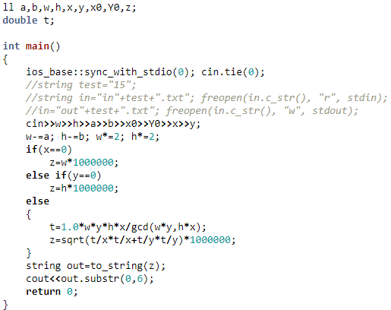
Code (c++)

Slide 19
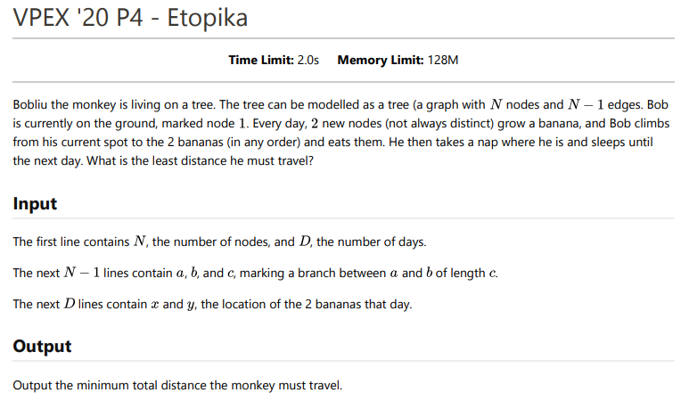
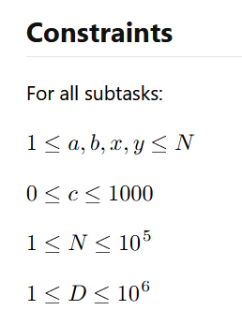
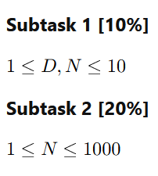

Slide 20
Subtask 1
Calculate the distance between 2 nodes using BFS or DFS. Calculate the distance travelled for every order of visiting the nodes and find the minimum.
Time complexity: N * 2^{D}
Key concepts required: graph theory, brute force

Slide 21
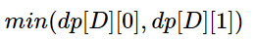
Subtask 2
Precompute the distance between any two nodes by doing a DFS or BFS from each node.
If nodes a₁ and b₁ had bananas yesterday, and nodes a₂ and b₂ had bananas today, you have four options today:
a₁ to a₂ to b₂, a₁ to b₂ to a₂, b₁ to a₂ to b₂, b₁ to b₂ to a₂
This can be solved using dynamic programming.
If dp[d][0] = distance travelled up to day d and ending on node a₂, and dp[d][1] ending on node b₂,
And the answer is
Because the monkey starts at node 1,
Time complexity: N²+D
Key concepts: graph theory, dynamic programming

Slide 22
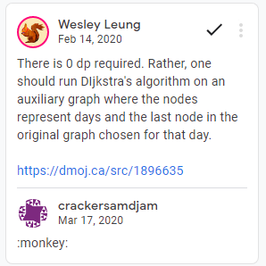
Full solution
This solution is similar to the solution to subtask 2. Instead of precomputing the distance between all pairs of nodes, we can find the distance between any two nodes by using their lowest common ancestor (LCA)
Time complexity: N+Dlog(N) or NlogN+D
Key concepts: graph theory, dynamic programming, sparse table

Slide 23
Code (c++)
https://codeforces.com/gym/104677/submission/227603818

Slide 24
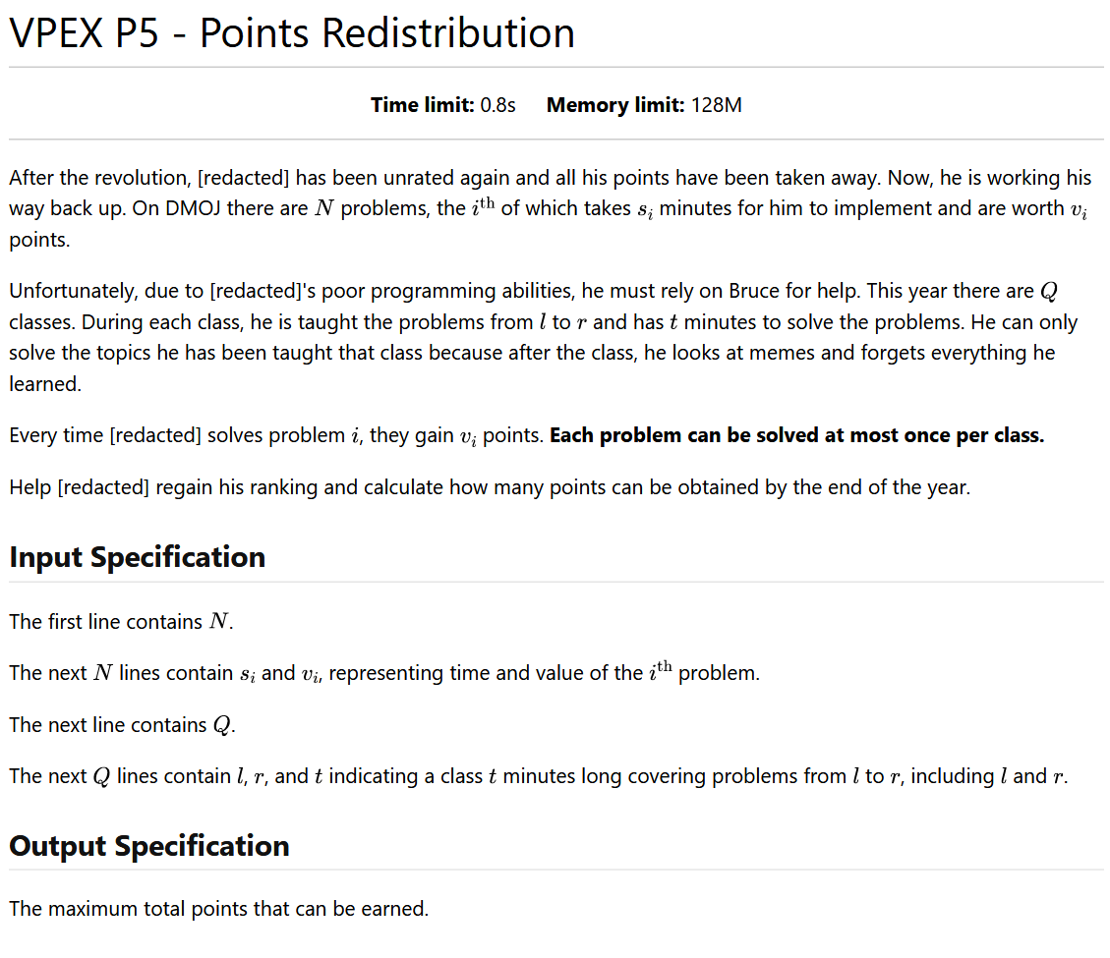
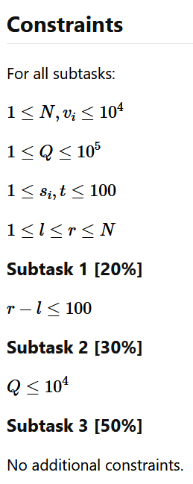
5

Slide 25
Subtask 1
For each query, solve the 0-1 knapsack problem with items between l and r
Key concepts: dynamic programming
Time complexity: NTQ (=max(r-l)*max(t)*Q)

Slide 26
Subtask 2
Create a segment tree with each node storing the best value in range l to r for every time t. Two nodes can be merged by trying all T^2 combinations of time spent in the left and right node. Merge the nodes in range during a query to get the answer.
Key concepts: segment tree, dynamic programming, implementation
Time complexity: Qt² * log N

Slide 27
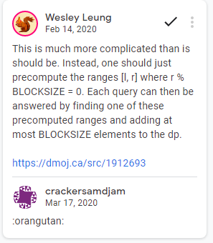
Full solution (Intended)
It is possible to solve all queries from l to r, l<=x<=r, with 2 dp tables, dp1[i][j]= maximum value with weight j in the range x+1 to i, dp2[i][j]=maximum with weight j from x-i to x. This table takes O(w(max(r)-min(l))) to create. With a query from l to r, ans=max(dp2[x-l][j]+dp[r][w-j]) for all j<=w. This query takes O(w) time.
Split the queries into 2 groups: r-l<=sqrt(n), r-l>sqrt(n). Sort both groups by l. Solve the queries with the method above using initially x=0, until a query is reached where l>x, then set x=r and repeat until all queries are solved.
Key concepts: offline processing, square root decomposition, dynamic programming, implementation
Time complexity: MN^{1.5}+MQ+Q log Q

Slide 28
Alternate solution (Recommended)
Begin with L=1, R=n, X=(L+R)/2. Solve all queries l to r where l<=X and r>X using the same method as the previous solution, a double ended dp array from X to L and X+1 to R. Then repeat the process with from L to X and from X+1 to R, and so on.
(Can be solved online with cdq table)
Key concepts: divide and conquer, dynamic programming, implementation
Time complexity: MN*logN+Q(M+logN)

Slide 29
Code (c++)
https://github.com/Aaerialys/contest-programming/tree/master/dmoj/.cpp
https://codeforces.com/gym/104677/submission/227604724 (Alternate solution)
https://codeforces.com/gym/104677/submission/227606202 (Original solution)

Slide 30
Bonus problem
Unused p6

Slide 31
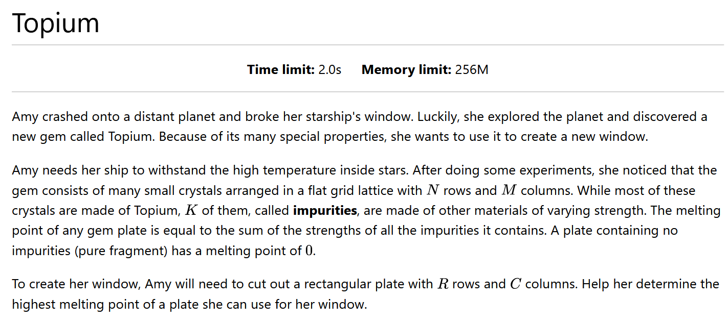

Slide 32
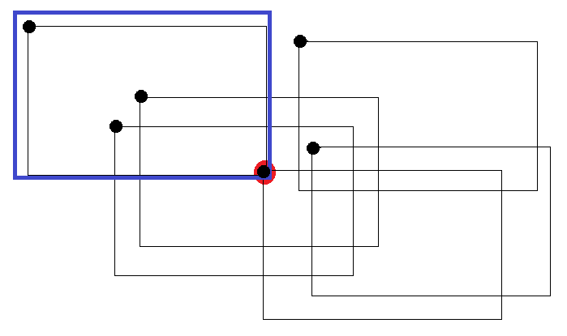
Solution
An impurity at (x,y) will be counted towards the melting point only if the top left corner of the plate is between (x-R,y-C) and (x,y).
T
The plate (black rectangle) will only contain the impurity (red dot) if the plate’s top left corner (black dot) is inside the blue box

Slide 33
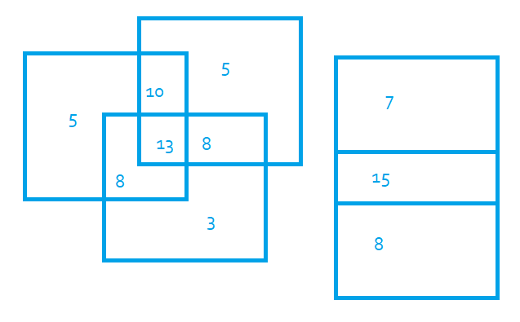
Solution
Draw the bounding rectangle of each impurity. Each rectangle has a value equal to the impurity strength. Find highest possible total value of rectangles covering a point.

Slide 34
Solution
To solve this problem, store the left and right edges of each rectangle and sort them by x coordinate. Perform a line across the x axis. Store the value of each point on the y axis using a segment tree. When a left edge from y1 to y2 of a rectangle of value v, add v to the segment tree from y1 to y2. When you reach a right edge, subtract v. Each time you add or subtract an edge, also find the maximum value in the segment tree. The maximum of these maximums will be your answer.
Coordinate compress the y values because they can be up to 10⁹.
Tips:
You cannot cut outside of the gem, all edges of your cut must be between (1,1) and (n,m)
Some impurities have negative values so in some cases it may be the best option to look for a pure fragment
Make sure you include all impurities inside your cut when adding up the values, even the negative ones

Slide 35
Solution
Key concepts: line sweep, segment tree, implementation
Time complexity: O(K*log M)

Slide 36
Code (c++)
https://codeforces.com/gym/104677/submission/227604751

Slide 37
Rankings

Slide 38
 | Name | School | Grade | handle | Side (left/right)
1 | gay | gay | 11 | Resolute | LEFT IS BEST TTTTTT
2 |  | UTS | 10 | Dormi | right
3 |  | SJAM | 10 | Dan13llljws
4 |  | VPCI | 11 | CatGirl
5 |  | VPCI | 10 | GeeTransit
6 |  | VPCI | 12 | Justin
7 |  | VPCI | 10 | deadfish
8 |  | MGCI | 12 | Tzak
9 |  | VPCI | 10 | Avan
10 |  |  |  | david
11 |  | VPCI | 10 | kevinyang
12 |  | VPCI | 10 | YucenX
13 |  | VPCI | 11 | NewAccount
14 |  | VPCI | 10 | BryanJ
 |  |  |  | laglaglag
16 |  | VPCI | 10 | aarushjain33555
17 |  | mgci | 11 | dhrumilp15

Slide 39
 | Name | School | Grade | handle | Side (left/right)
18 |  |  |  | josemago
19 |  | VPCI | 10 | Togohogo1
20 |  | VPCI | 9 | 13lack13lood
21 |  |  |  | paulsun
22 |  | VPCI | 12 | Vaaranan
23 |  |  |  | ErtYy
24 |  | VPCI | 12 | JimmyACookie
25 |  | VPCI | 10 | Stone_Yang
26 |  | VPCI | 10 | emilyyy333
27 |  | VPCI | 9 | jerryw
28 |  | VPCI | 9 | oskip123
29 |  | VPCI | 10 | jamsine
30 |  | VPCI | 9 | cyndie345678
31 |  | VPCI | 11 | franklai
32 |  | VPCI | 10 | madura30
33 |  | VPCI | 10 | ShengHong
34 |  | VPCI | 9 | asun18

Slide 40
Left side wins
monkey

Slide 41
Everybody gets a prize

Slide 42
The End
!bobliu
!bobliu
!bobliuu
Stop copying code bobliu

Slide 44

redacted
redacted
redacted
redacted
redacted
redacted

